Slide 1
STAGE BE-MOBILE
Maarten De Smedt – student/intern

Slide 2
TABLE OF CONTENTS
Stageopdracht: cloud-init & Ansible
Research
Testomgevingen opzetten
Kubernetes
Golang
API – Demo
API – Deployment

Slide 3
Cloud-init & Ansible

Slide 4
RESEARCH
Cloud-init & Hetzner Cloud
Cloud-init & Ansible

Slide 5



TEST OMGEVINGEN
Lokaal
Virtualbox & Vagrant
Basis cloud-init configuraties
Combinatie cloud-init & Ansible configuraties
Cloud
Hetzner Cloud
Basis cloud-init configuraties
Combinatie cloud-init & Ansible configuraties

Slide 6
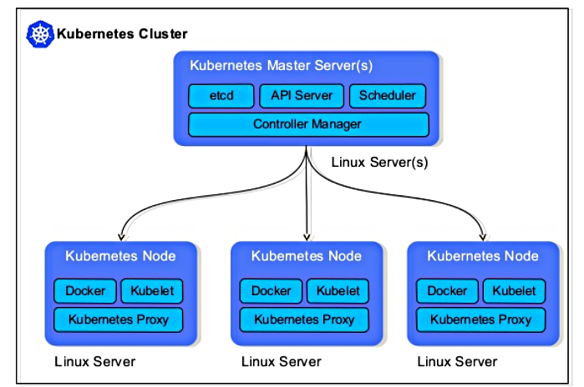
KUBERNETES
Testomgeving opzetten
3 Master nodes – 1 Worker node

Slide 7
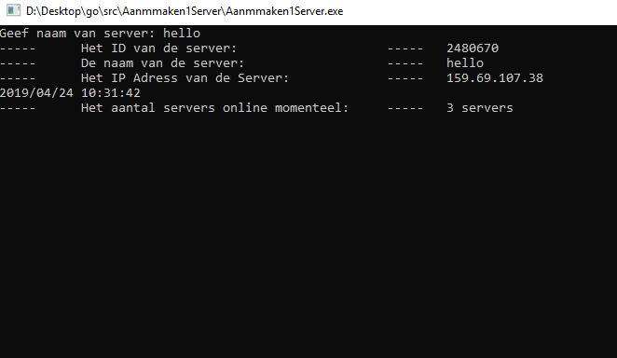
GOLANG
Hetzner servers beheren met Golang
3 Testprogramma’s
Servers verwijderen
Servers aanmaken
Server monitoring

Slide 8
API – DEMO
Programma → Server toevoegen aan netwerk en cluster
Combinatie kennis
Nieuwe kennis

Slide 9


API DEMO – PROGRAMS USED
Visual Studio Code
Postman

Slide 10
API DEMO – COMBINATIE
Golang
Cloud-init
Kubernetes
Ansible

Slide 11
API DEMO – NIEUW
Vault
Bastion
SSH Tunnel
Jenkins
Notes:
Jenkins is a self-contained, open source automation server which can be used to automate all sorts of tasks related to building, testing, and delivering or deploying software.

Slide 12
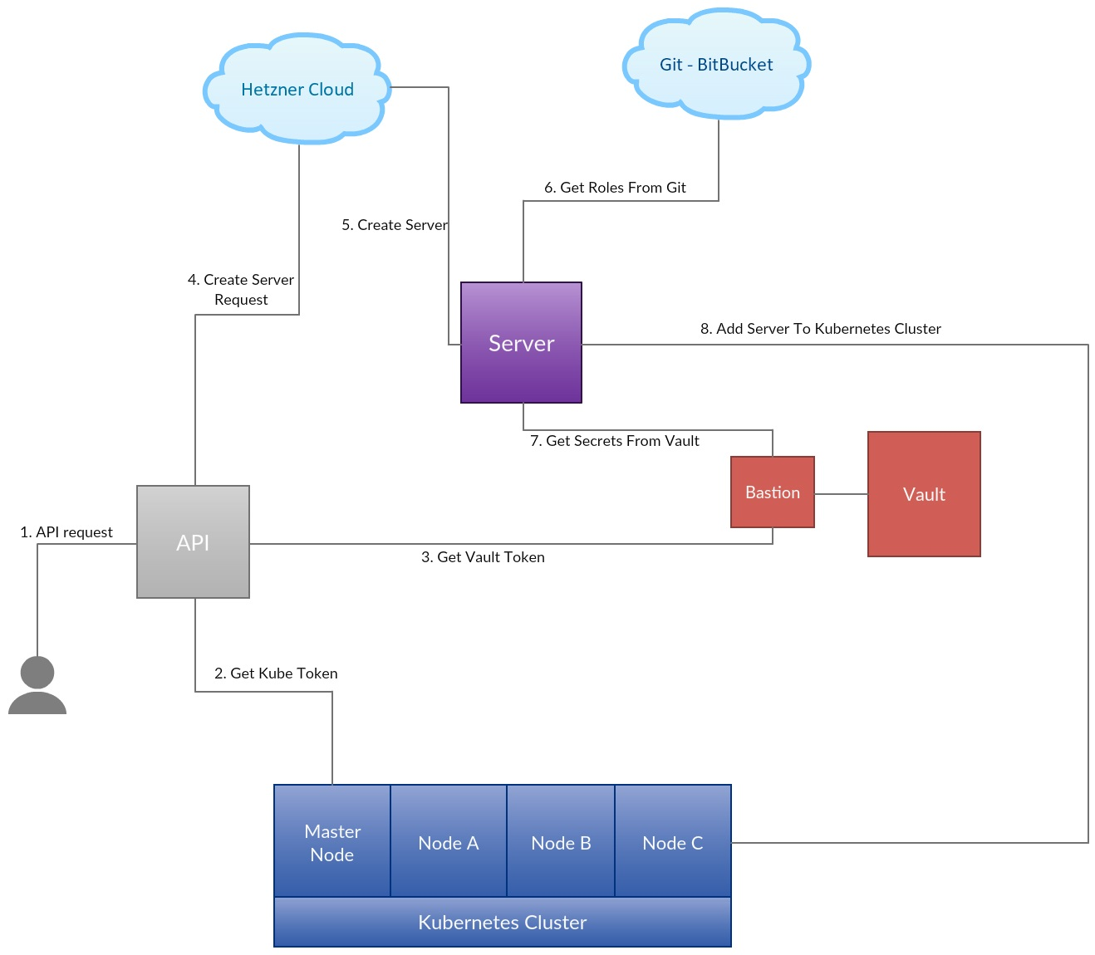
API – DEMO

Slide 13
info@be-mobile.com ⎹ www.be-mobile.com

